Slide 1
European Contractor Monitor H2-2021
Media orientation
January 2022

Slide 2
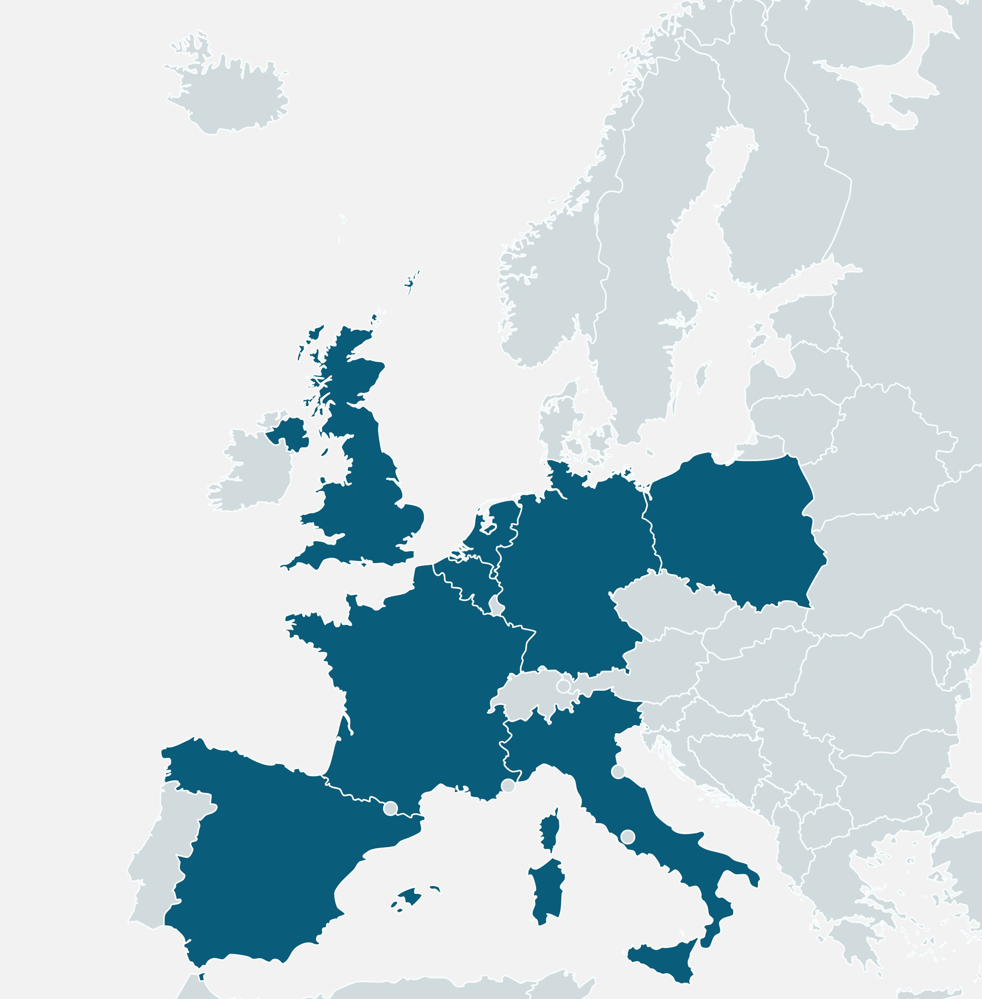
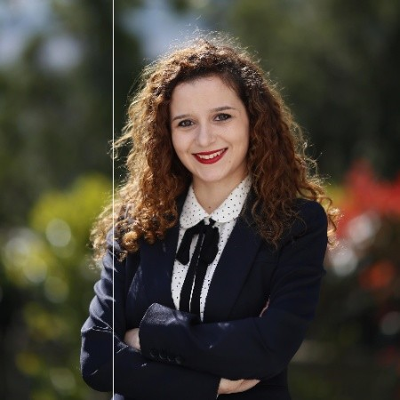
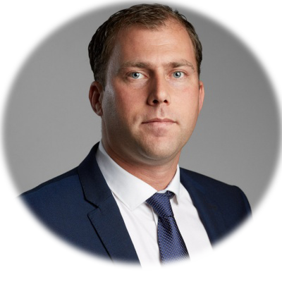
About European Contractor Monitor
THE GOAL
To get a picture of the economic situation in the construction market among contractors on a European scale and to get insights on the type of media channels that are being used, and for what purpose by the contractors. This research is done bi-annually, with registered contractors divided over the 8 major European markets.
COUNTRY SCOPE
(number of interviews conducted)
Background characteristics of the interviewed respondents can be found in the country-specific profiling the contractor chapter.
(100)
(125)
(100)
(125)
THE RESEARCH TOPICS
(125)
Recurring topic: Economic developments of construction companies in Europe (order book and turnover development)
(125)
(125)
Bi-annual theme topics in 2021/2022:
H2: Media orientation
H1: Prefab
(125)
THE TIMELINE
PROJECT TEAM
Report H2
Report H1
Eline Brussee
Project Manager
+31 638337644
brussee@usp-mc.nl
Esma Morgül
Research Analyst
morgul@usp-mc.nl
Dirk Hoogenboom
Research Consultant
+31 652098924
hoogenboom@usp-mc.nl
January
July

Slide 3
About target group & methodology
Surveying construction companies…
Mid-sized (5 to 15 employees) and large (more than 15 employees) building contractors who are active both in residential and non-residential segments are interviewed. Most interviews are conducted with owners/ directors or with purchasers of these companies.
… selected from a country-representative database
USP possesses an international database of construction companies, which is constantly updated. Therefore, respondents are not part of a fixed panel; the sample varies from wave to wave.
… through phone interviews, by native-speaking agents
Phone surveys are the best approach for obtaining a sufficient sample in order to provide insights that can be relied upon. These phone calls are made by fixed fieldwork partners, located in the respective countries.
… centralised and continuous quality control
Results in each country are monitored by the USP project team throughout the fieldwork period. We implement our extensive experience in order to make sure the answers are of high quality and provide the insights that meet the goal of the project.

Slide 4
Index
Management Summary
Profiling the Building Contractor
Media orientation

Slide 5
Business development
Recovery from the pandemic continues, turnover is XXX in most countries
In 2020, a major drop was experienced by many of the main contractors in Europe due to the pandemic, which hit the world economy hard in general. During H1 2021, we have seen that European contractors were XXX. This trend XXX in H2 2021.
Most European countries have experienced a XXX turnover development in H2 2021. Countries like Germany and the UK have experienced XXX.... XXX is the only country that is still struggling with the impact of the pandemic, but they do expect a positive turnover for the first half of 2022.
H1 outlook of the European countries XXX, impact of COVID-19 XXX
Expectations for the first half year of 2022 are XXX. European contractors expect that XXX in 2022 and the turnover will XXX. XXX contractors expect a big leap in turnover development. Countries such as the XXX and XXX are expecting a more negative impact of COVID-19 in 2022. Other European countries are more XXX and expect COVID-19 to have a similar XXX impact on their turnover as it had the previous half year.

Slide 6
Dummy data has been used on the following slides, this
means no real data of this edition is shown.

Slide 7
Management Summary | Profiling Building Contractor | Media Orientation
Most European contractors expect a XXX impact of COVID-19 in 2022. XXX and XXX are expecting a more XXX impact
Share of respondents expecting a negative impact of COVID-19 on their turnover
Do you expect that COVID-19 will impact your turnover in the next 6 months?
(% of companies expecting negative impact)
Germany | United Kingdom | France | Italy | Spain | Netherlands | Belgium | Poland
H2-20 | H1-21 | H2-21 |  | H2-20 | H1-21 | H2-21 |  | H2-20 | H1-21 | H2-21 |  | H2-20 | H1-21 | H2-21 |  | H2-20 | H1-21 | H2-21 |  | H2-20 | H1-21 | H2-21 |  | H2-20 | H1-21 | H2-21 |  | H2-20 | H1-21 | H2-21

Slide 8
Management Summary | Profiling Building Contractor | Media Orientation
XXX do have XXX expectations for the first half year of 2022
Net share of contractors’ experience regarding turnover
If you compare your turnover of H2-21 to H2-20, how did your turnover develop?
(Share of contractors reporting INCREASE minus the share of contractors reporting DECREASE in their turnover)
Germany | United Kingdom | France | Italy | Spain | Netherlands | Belgium | Poland
More experience positive
More experience negative

Slide 9
Management Summary | Profiling Building Contractor | Media Orientation
And the orderbook portfolios XXX in 2021
Order book portfolio
Question: How big is your current order book portfolio? For how many months will you be able to keep your current staff working?
(MONTHS)

Slide 10
Media Orientation
XXX and XXX are approached for information the most
European contractors most often rely on XXX as the immediate information source. XXX are mostly used when searching for XXX. There is a shift in importance, however….
COVID-19 impact on XXX
As expected, the pandemic had an impact on the XXX over the past two years. Since 2019, XXX decreased with 20%. A small percentage of the European contractors have XXX, but expectations are that XXX will increase more than XXX in the coming three years. The most mentioned reasons for the increase are the XXX…
XXX usage is increasing, XXX decreasing
The usage of XXX has been increasing since 2019, also in terms of frequency. The share of European contractors that used XXX has increased from more than X% in 2019 to more than X% in 2021. These channels are used mostly to XXX. Expectations are that XXX will be used more in the upcoming three years, whereas usage of XXX will decrease. Interestingly, there are only small differences in the media usage of XXX…

Slide 11
Management Summary | Profiling Building Contractor | Media Orientation
XXX are the most used media channels
Interesting differences between countries are that XXX…
Usage of digital and traditional media channels
% of contractors who make use of [media channel]
 | Europe | Germany | UK | France | Italy | Spain | Netherlands | Belgium | Poland
 | n=952 | n=125 | n=126 | n=125 | n=125 | n=126 | n=100 | n=100 | n=125
XXX |  | 50% | 50% | 50% | 50% | 50% | 50% | 50% | 50%
XXX |  | 50% | 50% | 50% | 50% | 50% | 50% | 50% | 50%
XXX |  | 50% | 50% | 50% | 50% | 50% | 50% | 50% | 50%
XXX |  | 50% | 50% | 50% | 50% | 50% | 50% | 50% | 50%
XXX |  | 50% | 50% | 50% | 50% | 50% | 50% | 50% | 50%
XXX |  | 50% | 50% | 50% | 50% | 50% | 50% | 50% | 50%
XXX |  | 50% | 50% | 50% | 50% | 50% | 50% | 50% | 50%
XXX |  | 50% | 50% | 50% | 50% | 50% | 50% | 50% | 50%
XXX |  | 50% | 50% | 50% | 50% | 50% | 50% | 50% | 50%
XXX |  | 50% | 50% | 50% | 50% | 50% | 50% | 50% | 50%
XXX |  | 50% | 50% | 50% | 50% | 50% | 50% | 50% | 50%

Slide 12
Management Summary | Profiling Building Contractor | Media Orientation
In comparison to 2019, there are some changes in media usage
It is clear that XXX…
Usage of digital and traditional media channels 2019 - 2021
% of contractors who make use of [media channel]
 | Europe 2021 | Europe 2019 | GE | UK | FR | IT | SP | NL | BE | PL
 | n=952 | n=1200 | 2019 - 2021
XXX |  |  | 50% | 50% | 50% | 50% | 50% | 50% | 50% | 50%
XXX |  |  | 50% | 50% | 50% | 50% | 50% | 50% | 50% | 50%
XXX |  |  | 50% | 50% | 50% | 50% | 50% | 50% | 50% | 50%
XXX |  |  | 50% | 50% | 50% | 50% | 50% | 50% | 50% | 50%
XXX |  |  | 50% | 50% | 50% | 50% | 50% | 50% | 50% | 50%
XXX |  |  | 50% | 50% | 50% | 50% | 50% | 50% | 50% | 50%
XXX |  |  | 50% | 50% | 50% | 50% | 50% | 50% | 50% | 50%
XXX |  |  | 50% | 50% | 50% | 50% | 50% | 50% | 50% | 50%
XXX |  |  | 50% | 50% | 50% | 50% | 50% | 50% | 50% | 50%
XXX |  |  | 50% | 50% | 50% | 50% | 50% | 50% | 50% | 50%
XXX |  |  | 50% | 50% | 50% | 50% | 50% | 50% | 50% | 50%

Slide 13
Management Summary | Profiling Building Contractor | Media Orientation
Compared to 2019, there are also developments in terms of frequency
In general, there is an increase in frequency of usage of XXX as information source, as well as XXX. However, XXX…
Usage of digital and traditional media channels at least once in three months 2019 - 2021
% of contractors who make use of [media channel] at least once in three months
 | Europe 2021 | Europe 2019 | GE | UK | FR | IT | SP | NL | BE | PL
 | n=952 | n=1200 | 2019 – 2021
XXX |  |  | 50% | 50% | 50% | 50% | 50% | 50% | 50% | 50%
XXX |  |  | 50% | 50% | 50% | 50% | 50% | 50% | 50% | 50%
XXX |  |  | 50% | 50% | 50% | 50% | 50% | 50% | 50% | 50%
XXX |  |  | 50% | 50% | 50% | 50% | 50% | 50% | 50% | 50%
XXX |  |  | 50% | 50% | 50% | 50% | 50% | 50% | 50% | 50%
XXX |  |  | 50% | 50% | 50% | 50% | 50% | 50% | 50% | 50%
XXX |  |  | 50% | 50% | 50% | 50% | 50% | 50% | 50% | 50%
XXX |  |  | 50% | 50% | 50% | 50% | 50% | 50% | 50% | 50%
XXX |  |  | 50% | 50% | 50% | 50% | 50% | 50% | 50% | 50%
XXX |  |  | 50% | 50% | 50% | 50% | 50% | 50% | 50% | 50%
XXX |  |  | 50% | 50% | 50% | 50% | 50% | 50% | 50% | 50%

Slide 14
Management Summary | Profiling Building Contractor | Media Orientation
Digital usage is also seen in the devices they use for social media. Since 2019, there is a slow shift going on from XXX to XXX
Which device is used the most when searching information on…?
Social media 2021
Social media 2019
Desktop | Laptop | Tablet | Smart Phone | Don’t know

Slide 15
Management Summary | Profiling Building Contractor | Media Orientation
There are no big differences in media usage of generations, however.
Although XXX tends to use more XXX for work purposes than XXX.
Usage of digital and traditional media channels
% of contractors who make use of [media channel]
 | Europe | Generation Y | Generation X | Baby boomers
 | n=952 | n=197 | n=456 | n=242
XXX |  | 50% | 50% | 50%
XXX |  | 50% | 50% | 50%
XXX |  | 50% | 50% | 50%
XXX |  | 50% | 50% | 50%
XXX |  | 50% | 50% | 50%
XXX |  | 50% | 50% | 50%
XXX |  | 50% | 50% | 50%
XXX |  | 50% | 50% | 50%
XXX |  | 50% | 50% | 50%
XXX |  | 50% | 50% | 50%
XXX |  | 50% | 50% | 50%

Slide 16
Management Summary | Profiling Building Contractor | Media Orientation
European contractors expect that some traditional media channels will XXX in the future, while XXX will increase
Usage expectations of digital and traditional media channels 2021
% of contractors who believe usage of [media channel] will increase, decrease or remain the same in the upcoming 3 years
Media channel | Increase | Remain the same | Decrease
XXX | 50% | 50% | 50%
XXX | 50% | 50% | 50%
XXX | 50% | 50% | 50%
XXX | 50% | 50% | 50%
XXX | 50% | 50% | 50%
XXX | 50% | 50% | 50%
XXX | 50% | 50% | 50%
XXX | 50% | 50% | 50%
XXX | 50% | 50% | 50%
XXX | 50% | 50% | 50%
XXX | 50% | 50% | 50%
XXX | 50% | 50% | 50%
XXX | 50% | 50% | 50%
Notes:
Veritcal bar chart basic with comparison (e.g. age, region etc.)

Slide 17
Index
Management Summary
Profiling the Building Contractor
Media orientation

Slide 18
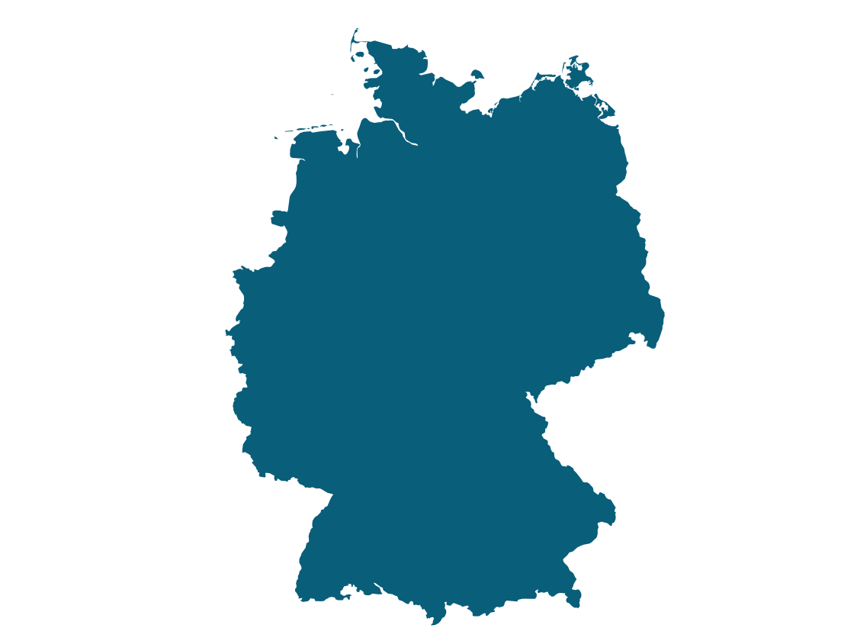
Management Summary | Profiling the Building Contractor| Media Orientation
Germany | United Kingdom | France | Italy | Spain | Netherlands | Belgium | Poland
Background characteristics
Company profile
How many full-time employees does your company have?
Project segmentation
What percentage of your turnover do you get from … projects?
5-15 fte | ≥16 fte
50% | 50%
Residential
Non-residential
GERMANY
Base: n=125, asked to all contractors

Slide 19
Management Summary | Profiling the Building Contractor| Media Orientation
Germany | United Kingdom | France | Italy | Spain | Netherlands | Belgium | Poland
Most of the German contractors expect XXX impact of COVID-19 on their turnover
The effect of COVID-19 on the turnover
Do you expect corona virus will impact your turnover in the next 6 months?
If yes, in which type of projects do you expect this impact? (prompted)
Yes, positively | No impact | Yes, negatively | Do not know
5-15 fte | > 15 fte
Total
5-15 fte
> 15 fte
Residential New build | Residential Renovation | Non-residential New build | Non-Residential Renovation | Don’t know
Base: n=125, asked to all contractors
Base: n=31, asked to those who expect COVID impact. Multiple answers allowed.

Slide 20
Management Summary | Profiling the Building Contractor| Media Orientation
Germany | United Kingdom | France | Italy | Spain | Netherlands | Belgium | Poland
And they also expect a more XXX turnover for H1 2022
How big is your current order book portfolio?
For how many months will you be able to keep your current staff working?
Net share of contractors’ experience regarding turnover
If you compare your turnover of H2-21 to H2-20, how did your turnover develop?
What are your expectations for the development in H1-22?
ORDER BOOK
(MONTHS)
(Share of contractors reporting INCREASE minus the share of contractors reporting DECREASE in their turnover)
COMPARISON to the previous half year
MORE POSITIVE
H2-18
H1-19
H2-19
H1-18
H1-18
EU
H1-21
H1-20
H2-20
DE
MORE NEGATIVE
Base: n=125, asked to all contractors

Slide 21
Index
Management Summary
Profiling the Building Contractor
Media orientation

Slide 22
Management Summary | Profiling Building Contractor | Media Orientation |
Germany | United Kingdom | France | Italy | Spain | Netherlands | Belgium | Poland
Media usage in Germany
This chapter answers the following questions regarding media usage in Germany.
Which media channels are used the most?
How often are different media channels used?
What are the expectations for the usage of these channels in the next three years?
What channel is used for what specific information?
Which information sources are most helpful when searching for product-specific information, service and advice, news on innovation and market developments, and when taking a purchase decision?
The media channels investigated are selected based on hard evidence collected in previous studies as well as our market knowledge:
Manufacturers*
Professional wholesalers of building materials*
Trade fairs/ trade shows*
Trade journals/ magazines*
Social media
Mobile apps
Printed newsletters
Digital newsletters
GERMANY
Base=125 *Randomized among the respondents

Slide 23
Management Summary | Profiling Building Contractor | Media Orientation |
Germany | United Kingdom | France | Italy | Spain | Netherlands | Belgium | Poland
Usage frequency of manufacturer and wholesaler media
Manufacturer media
Usage | Website | Representative | Brochures/ Leaflets
Users | 50% | 50% | 50%
At least once a week | 50% | 50% | 50%
Once a month | 50% | 50% | 50%
Once in 3 months | 50% | 50% | 50%
Less often than 3 months | 50% | 50% | 50%
Never | 50% | 50% | 50%
Wholesaler media
Usage | Website | Representative
Users | 50% | 50%
At least once a week | 50% | 50%
Once a month | 50% | 50%
Once in 3 months | 50% | 50%
Less often than 3 months | 50% | 50%
Never | 50% | 50%
Most used device when searching information on websites
Top 3 Information search on websites
Desktop | Laptop | Tablet/ Ipad | (Smart) phone
 | Manufacturer website | Wholesaler website
1 | XXX | XXX
2 | XXX | XXX
3 | XXX | XXX
Manufacturer’s website
Wholesaler’s website

Slide 24
Management Summary | Profiling Building Contractor | Media Orientation |
Germany | United Kingdom | France | Italy | Spain | Netherlands | Belgium | Poland
Sources used for finding specific information
Most helpful information sources to search for
Product specific information
Services and advice
XXX
XXX
XXX
XXX
XXX
XXX
XXX
XXX
XXX
XXX
Innovations, trends and developments
Taking a purchase decision
XXX
XXX
XXX
XXX
XXX
XXX
XXX
XXX
XXX
XXX

Slide 25
Management Summary | Profiling Building Contractor | Media Orientation |
Germany | United Kingdom | France | Italy | Spain | Netherlands | Belgium | Poland
Top 3 information searches on wholesaler and manufacturer media
What specific information do you usually search for via…
Manufacturer website
Top 3 of 2021 | % | Top 3 of 2019 | %
XXX | 50% | XXX | 50%
XXX | 50% | XXX | 50%
XXX | 50% | XXX | 50%
Wholesaler website
Top 3 of 2021 | % | Top 3 of 2019 | %
XXX | 50% | XXX | 50%
XXX | 50% | XXX | 50%
XXX | 50% | XXX | 50%
Manufacturer representative
Top 3 of 2021 | % | Top 3 of 2019 | %
XXX | 50% | XXX | 50%
XXX | 50% | XXX | 50%
XXX | 50% | XXX | 50%
Wholesaler representative
Top 3 of 2021 | % | Top 3 of 2019 | %
XXX | 50% | XXX | 50%
XXX | 50% | XXX | 50%
XXX | 50% | XXX | 50%
Manufacturer brochures/ leaflets
Top 3 of 2021 | % | Top 3 of 2019 | %
XXX | 50% | XXX | 50%
XXX | 50% | XXX | 50%
XXX | 50% | XXX | 50%

Slide 26
Management Summary | Profiling Building Contractor | Media Orientation |
Germany | United Kingdom | France | Italy | Spain | Netherlands | Belgium | Poland
Development of media usage from 2019 to 2021
Manufacturer website | Manufacturer representative | Manufacturer brochures | Wholesaler website | Wholesaler representative
2019
2021
100%
Usage for at least once in 3 months
0%
Trade shows* | Trade magazines | Social Media | Mobile apps | Digital newsletters | Printed newsletters
100%
0%
*Trade show has been visited at least once in the last 2 years

Slide 27
Management Summary | Profiling Building Contractor | Media Orientation |
Germany | United Kingdom | France | Italy | Spain | Netherlands | Belgium | Poland
Online events attended by German contractors
Would like to continue after the COVID-19 crisis with online events
Have you attended any online seminars, presentations, or events organized by manufacturers during the COVID-19 crisis?
Open answers
Open answers
Yes | No
Open answers
Open answers
Open answers
Would you like these online events to continue after the COVID-19 crisis?
Would not like to continue after the COVID-19 crisis with online events
Open answers
Open answers
Yes | No | Don’t know
Open answers
27
27
27

Slide 28
Management Summary | Profiling Building Contractor | Media Orientation |
Germany | United Kingdom | France | Italy | Spain | Netherlands | Belgium | Poland
Usage of XXX
XXX
Top 5 specific information usually searched for on a
manufacturer's website
XXX
XXX
XXX
XXX
XXX
XXX
50%
of the German contractors are using XXX to search for information
Frequency of usage of manufacturers' websites
Expectation frequency of usage in the upcoming 3 years
At least once a week | Once a month | Once in 3 months | Less than in 3 months | Never
Increase | Remain the same | Decrease
Total
5-15 FTE
> 15 FTE

Slide 29
About USP
USP Marketing Consultancy
Research in
Market specialist
installation, construction, home improvement and real estate
34
countries annually
Dedicated and multi-client research
Head office
Subsidiary
Active in the market for over 25 years
230+ dedicated market research
projects annually
78
1,162
focus groups
in-depth interviews
Rotterdam
Düsseldorf
Total
Revenue distribution
70
Research Analysts
Project managers
70%
90%
70%
58,653
56,750
B2B CATI interviews
B2C online interviews
turnover coming from international projects
turnover coming from dedicated market research, 10% from multi client
turnover coming from B2B, 30% B2C
Consultants

Slide 30
What we do
Examples
Dedicated market research
Tailor made
Driven by your information needs
Advice & consultancy based on facts and over 25 years of experience in the industry
Worldwide coverage
B2B, B2C, qualitative and quantitive research or a combination of both
Within our market specialism, all types of researches can be conducted
Targeting the right audience, with the right questions at the right time.
Segmentation
Customer journey
Branding
Concept/
product research
Customer satisfaction
Trends
Distribution research
Market exploration
Pricing
Market size
30

Slide 31
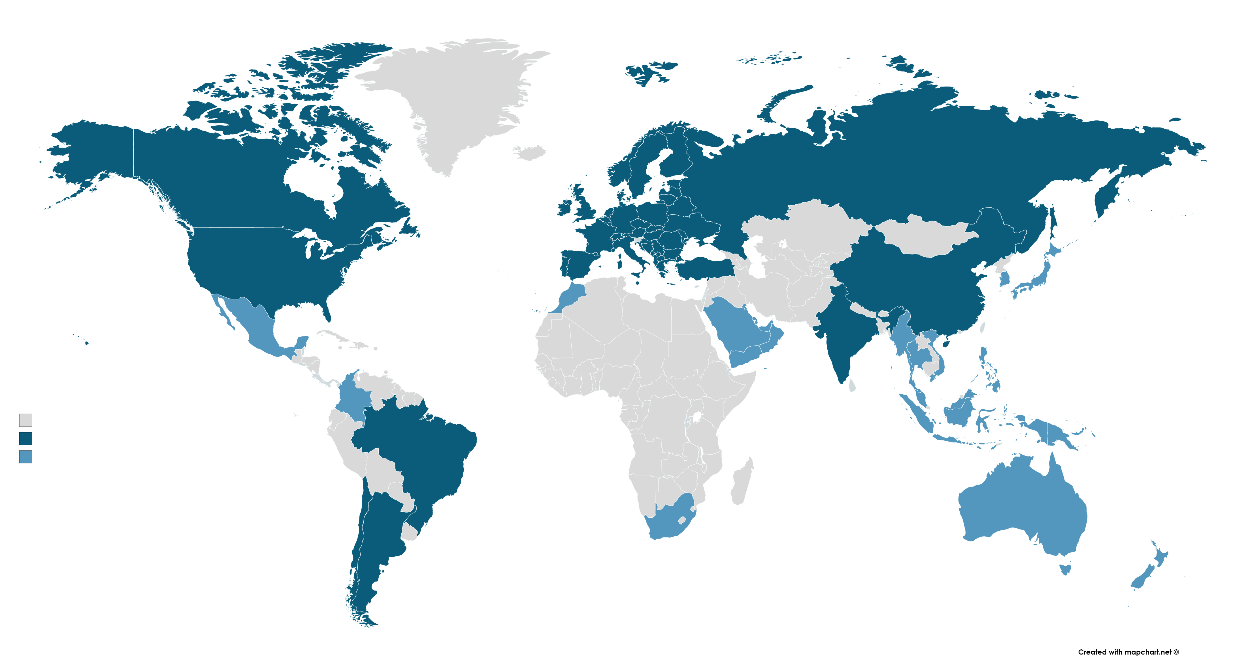
We are active globally
Countries which we continuously research
Other countries which have been
researched in past 2 years
31

Slide 32
Principals of USP
Construction
DIY
Installation
0

Slide 33
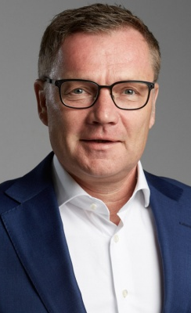
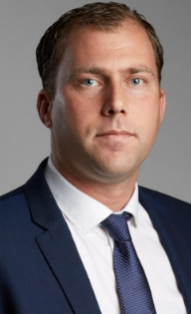
For questions and more information
Jan-Paul Schop
Managing Director
Schop@usp-mc.nl
+31 6 55786342
Zeynep Kutsal
Project Manager
Brussee@usp-mc.nl
+31 6 38337644
Dirk Hoogenboom
Research Consultant
Hoogenboom@usp-mc.nl
+31 6 52098924
Max Euwelaan 51
3062 MA Rotterdam
+31-10-2066900
info@usp-mc.nl
https://www.usp-mc.nl/en/
© January, 2022 USP Marketing Consultancy B.V.
The information in this publication is strictly confidential and all relevant copyrights, database rights and other (intellectual) property rights are explicitly reserved.
No part of this publication may be reproduced and/or published without the prior written permission of USP Marketing Consultancy B.V.

